Slide 1
Secrets Hub

Slide 2
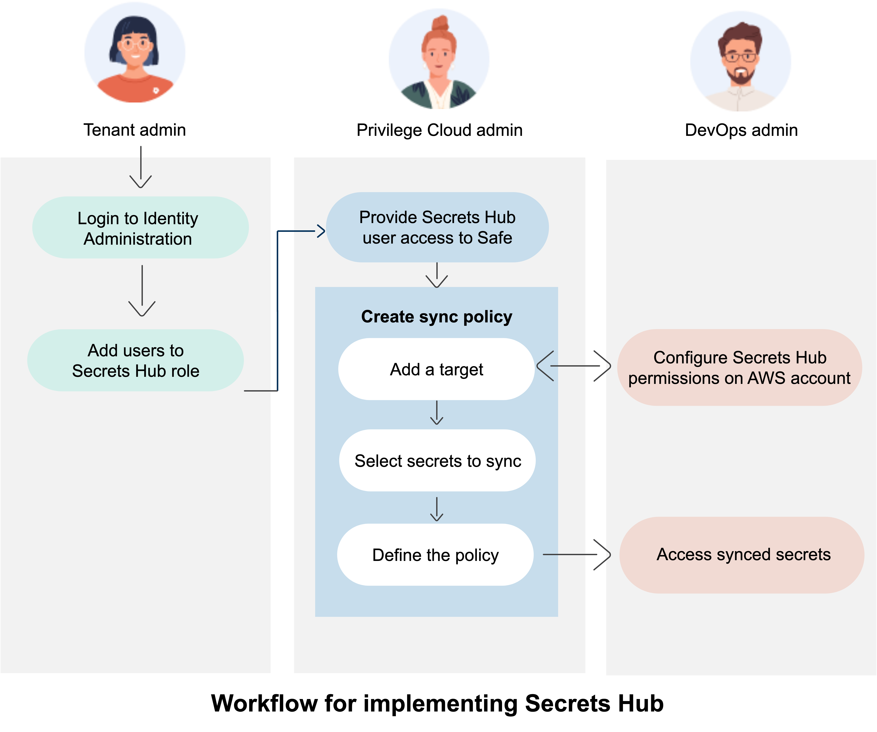
Secrets Hub – Workflow
In PVWA:
Add SecretsHub user to CyberArk Safe
In AWS Cloud Formation:
Add SecretsHub Role to AWS account
Grants SecretsHub access to AWS Secrets Manager (ASM)
In SecretsHub Console:
Create Target object for AWS account
Create Sync policy naming Safe and AWS Account
Changes in Safes are synced to ASM every minute
Rotations
New accounts
Option to create secrets first in ASM
A Deny policy can be applied to to make SecretsHub-managed secrets read-only
AWS Account admin
safes
safes

Slide 3
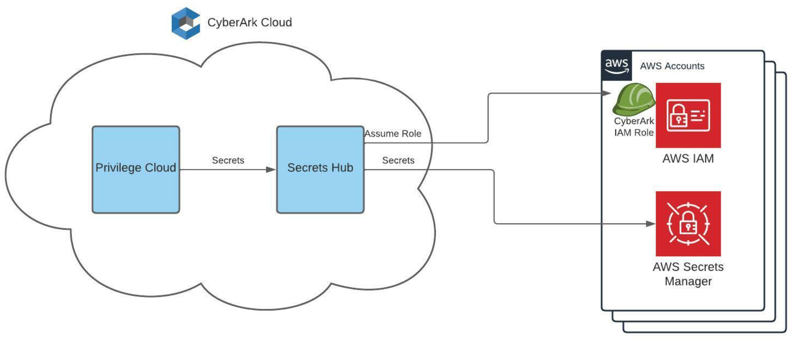
Secrets Hub – Architecture (early access)

Slide 4
ASCP

Slide 5
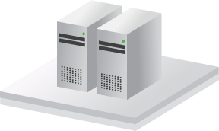












Traditional Application Access: High level perspective
Application Identity Management
Applications
Application Servers (WebSphere, Weblogic, etc.)
Secure Storage
Databases
Security Appliances
*****
Applications
Unix Servers
CyberArk Vault
Password and SSH Key Rotation
Network Devices
Servers
Applications
Windows Servers
Username = GetUserName()
Password = GetPassword()
Host = GetHost()
ConnectDatabase(Host, Username, Password)
Username =
Password =
Host =
ConnectDatabase(Host, Username, Password)
“app”
“y7qeF$1”
“10.10.3.56”
Websites/ Web Apps
Cloud Infrastructure
Applications
Mainframe Servers
Applications
Desktops
Notes:
Applications can reside anywhere in an organization, be it servers or desktops. Unix Servers, Windows Servers, Mainframes, Application servers, such as WebSphere, Weblogic, etc.
<CLICK 1>
Typically, these applications will need to connect to a remote resource, such databases, web application, cloud infrastructure, and even simply other servers.
In order to connect and communicate with these resources, the application must use credentials, and as we saw earlier these credentials are naturally hard-coded into the application code, which expose them to attackers and insider threats.
<CLICK 2>
Moreover, these credentials are almost never changed, because they have been hard-coded into tons of applications throughout the organization.
How does CyberArk overcome these challenges?
First thing’s first – remove the hard-coded credential from the application code.
CyberArk Application Identity Manager enables the complete elimination of hard-coded and embedded credentials in applications by replacing them with SDKs. The credential are stored in Vault, and are retrieved using the SDK inside the application code.
Credentials, be it password or SSH keys, can then be easily rotated based on the organization policy and the application will transparently use these new credentials whenever required,
Let’s have a look at how this works.
Attackers or malicious insiders will eventually get access to these credentials, so what we need to do is store them in the Vault
<CLICK 3>
This will secure them and enable their frequent rotation
Then, we must get rid of these hard-coded credentials <CLICK 4> and replace them with SDK calls
<CLICK 5>
This will enable applications to retrieve the credentials stored and secured in the Vault
<CLICK 6> When a credential is required by an application it is retrieved from the Vault to the application, and then used to authenticate to whichever resource it is required.
And this summarized the high-level concept of AIM – Application Identity Manager.
Let’s now go on and discuss all of AIM’s benefits
<CLICK 7>

Slide 6



But why change code? J2EE
Integration with Java Application Servers enables the transparent management of datasource credentials for: WebSphere, WebLogic, JBoss, Tomcat
Requires no code changes to the J2EE application. One-time configuration change to the application server.
Server
WebSphere
J2EE
Application
Database
Application Server Credential Provider
CyberArk Vault
Notes:
The third solution included in AIM, is a solution for Java Application Servers.
This is a solution for the transparent management of datasource credentials, the credentials used by the application servers to connect to databases and other assets at the heart of the enterprise.
<CLICK 1>
Among the SDKs CyberArk AIM offers is a Java SDK, through which Java applications can retrieve credentials, as we have seen in the previous slides.
But why change the code of all application when you can make a one time configuration change in the Application Server itself?
CyberArk has developed and patentized an innovative solution that eliminates hard-coded credentials in Java Applications servers without needing to change a single line of code, which as we know, can be a big challenge to orchestrate.
<CLICK 2>
The Application Server Credential Provider is installed on the Java Application Server, just like the Credential Provider we saw in the previous slides.
<CLICK 3>
Similar to the Credential Provider, everytime the Java application requires a credential, it is retrieved from the Vault, stored in the cache, and the connection is established by the Java Application Server.
The credential never makes it to the application itself.
The Application Server Credential Provider is very popular for the beginning of AIM projects, since it requires no code changes, and is very easy to implement.

Slide 7

But why change code? J2EE
Integration with Java Application Servers enables the transparent management of datasource credentials for: WebSphere, WebLogic, JBoss, Tomcat
Requires no code changes to the J2EE application. One-time configuration change to the application server.
Server
WebSphere
J2EE
Application
Database
Application Server Credential Provider
CyberArk Vault
Notes:
The third solution included in AIM, is a solution for Java Application Servers.
This is a solution for the transparent management of datasource credentials, the credentials used by the application servers to connect to databases and other assets at the heart of the enterprise.
<CLICK 1>
Among the SDKs CyberArk AIM offers is a Java SDK, through which Java applications can retrieve credentials, as we have seen in the previous slides.
But why change the code of all application when you can make a one time configuration change in the Application Server itself?
CyberArk has developed and patentized an innovative solution that eliminates hard-coded credentials in Java Applications servers without needing to change a single line of code, which as we know, can be a big challenge to orchestrate.
<CLICK 2>
The Application Server Credential Provider is installed on the Java Application Server, just like the Credential Provider we saw in the previous slides.
<CLICK 3>
Similar to the Credential Provider, everytime the Java application requires a credential, it is retrieved from the Vault, stored in the cache, and the connection is established by the Java Application Server.
The credential never makes it to the application itself.
The Application Server Credential Provider is very popular for the beginning of AIM projects, since it requires no code changes, and is very easy to implement.

Slide 8
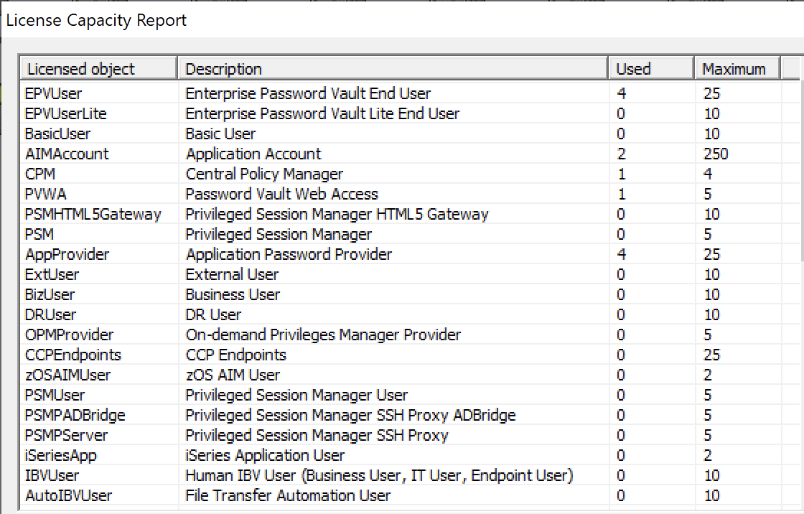
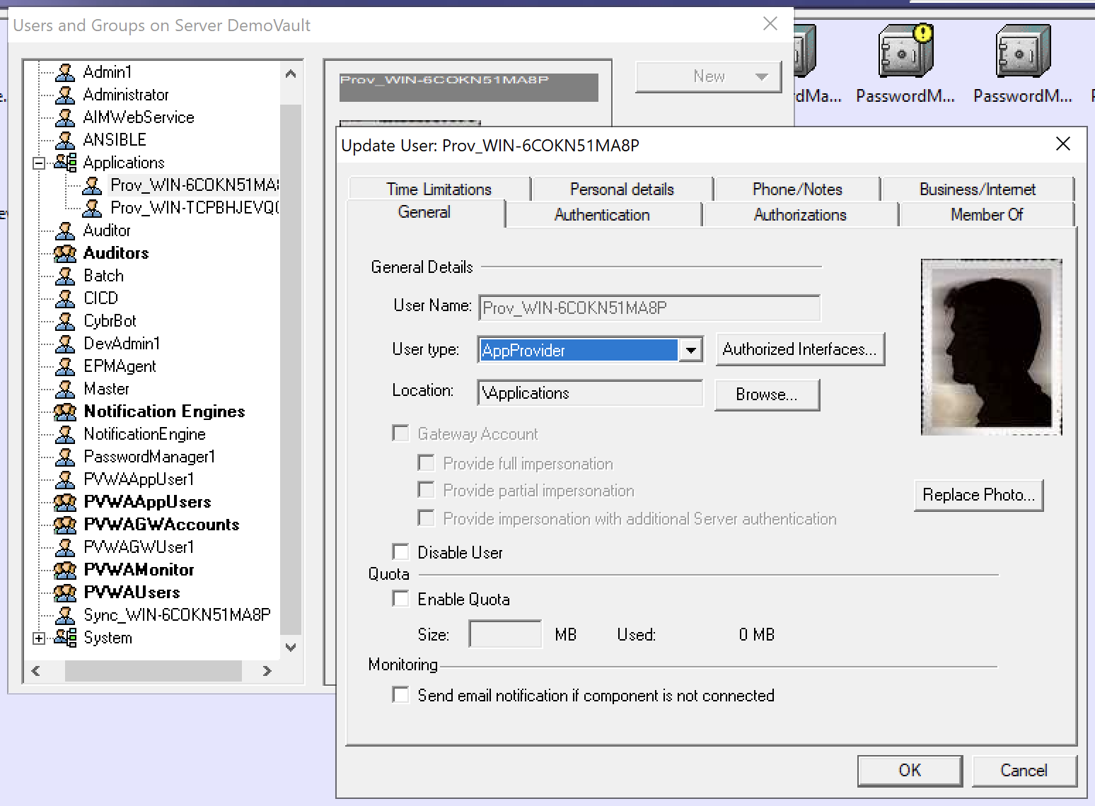
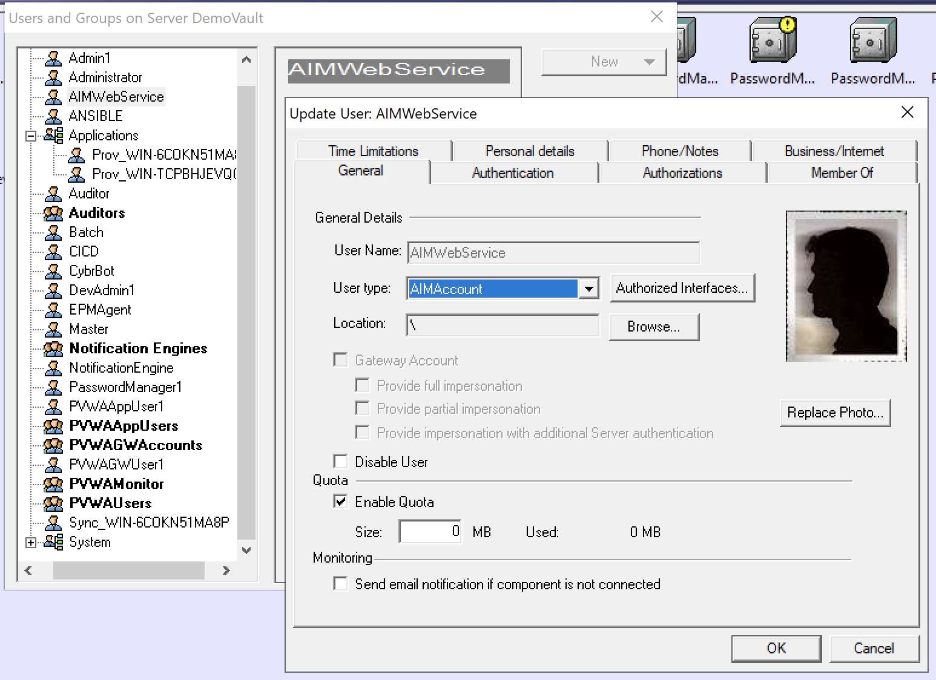
CyberArk Secrets Management CP Solution Licensing
AppProvider
AppProvider
AppProvider
Agent-Based
Agentless
CCPEndpoint
443
app
SDK
app
CyberArk
Vault
REST
CP
AIMAccount
CP
AIMAccount
1858
script
script
CLI
REST
Credential Provider
Central Credential Provider
AIMAccount
AIMAccount
AIMAccount
CP/CCP/ASCP Licensing Terminology
Represented in License Capacity Report:
AppProvider == Credential Provider agent
Licensed: APP_STATIC_xxx, APP_ISV_xxx, APP_RPA_xxx SKUs
Unlicensed (no $$): Sync/LOB users
Tracked & enforced by license manager
AIMAccount == Application ID (AppID) in PVWA
Not licensed (no $$), provided as ~10x AppProvider count
More can be allocated w/ support ticket
Tracked & enforced by license manager
CCPEndpoints == Calling system hosting apps calling CCP
Licensed: APP_STATIC_xxx, APP_ISV_xxx, APP_RPA_xxx SKUs
Not tracked or enforced by license manager
Licensing Terminology:
Calling System == a host/IP-address calling CP/ASCP/CCP
Primarily used for licensing custom/in-house built applications
Not represented directly in License Capacity Report
APP_STATIC_xxx SKU
Map to CP/ASCP AppProviders + CCPEndpoints
Third-party/ISV/RPA license units are product-specific
Robotic Process Automation (RPA) Solutions
APP_RPA_xxx SKU
Licensed per bot
Non-RPA solutions
APP_ISV_xxx SKU
Examples:
Vulnerability scanners -> licensed per scanning engine
ServiceNow -> licensed per mid server
Config
Files
J2EE App Server
CP
DS
app
Application Server Credential Provider
CPM Push-to-File
Conjur Enterprise
Calling System
Calling System
Calling System

Slide 9
Encryption-as-a-Service

Slide 10

Thales Cipher Trust & Cyberark conjur
Thales Cipher Trust Solution provides:
On Demand Encryption/Decryption
Data Tokenization
Transparent Database Encryption
Workflow:
CyberArk CPM manages the Thales CipherTrust password.
Apps authenticate to Conjur to retrieve the Thales CipherTrust password, gaining access to encryption services and keys.
Together, the Thales CipherTrust Solution and CyberArk Secrets Manager are the best-of-breed solution for ephemeral data protection needs.
Solution page: https://cpl.thalesgroup.com/encryption/data-security-platform

Slide 11


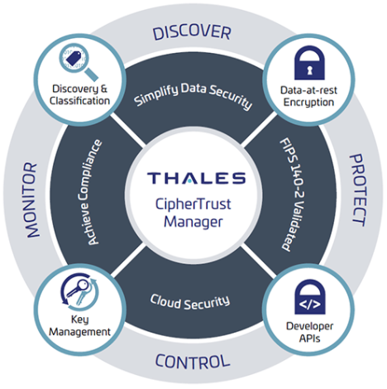
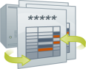

Thales/Cyberark integration workflow
CyberArk CPM manages the CipherTrust password.
The password is synchronized to CyberArk Conjur.
The Application authenticates to Conjur and retrieves the CipherTrust password.
The Application Logs into CipherTrust to complete encryption/tokenization tasks.
2
CyberArk Vault
Conjur
3
Application
1
4
Central Policy Manager

